Slide 1
Assignment 2 Presentation
Zunaira Abdul Aziz
BSSE23058

Slide 2
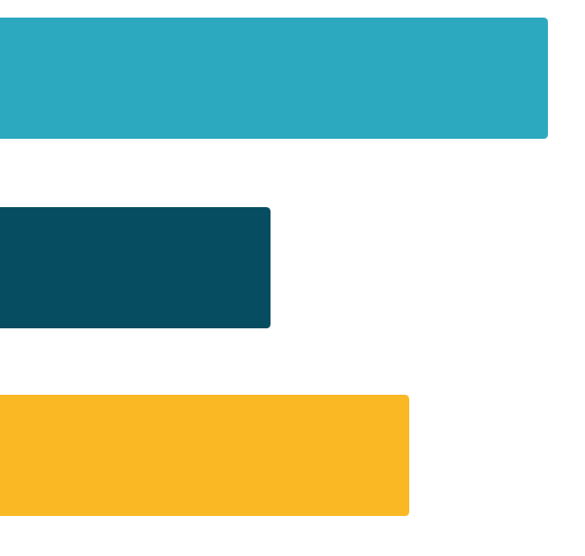
Brahma: Social Reformer in Hindu
Brahma, a central figure in Hindu mythology, is revered as the creator deity responsible for shaping the universe and guiding human life.
This presentation delves into Brahma's life stories and their profound impact on social reform and enlightenment in Hindu society.

Slide 3
02
01
The Creation of Saraswati
Birth from the Lotus
Brahma, desiring a companion to aid in the process of creation, meditated deeply and created Saraswati, the goddess of knowledge and wisdom.
Saraswati's existence highlights Brahma's reverence for learning and enlightenment, encouraging society to prioritize education and intellectual growth.
Brahma is said to have emerged from a lotus flower that blossomed from the navel of Lord Vishnu while he slept on the cosmic ocean.
This miraculous birth symbolizes the power of creation and innovation, inspiring individuals to embrace their inherent potential for transformation.
03
Brahma's Sacrifice for Knowledge
In one legend, Brahma severed his fifth head as a sacrifice to uphold the sanctity of truth and knowledge.
This act demonstrates Brahma's commitment to upholding moral and ethical principles, inspiring individuals to prioritize truthfulness and integrity in their actions.

Slide 4
04
05
The Story of Prajapati Daksha
Brahma's Role as the Creator
Brahma's grandson, Daksha, organized a grand yajna (ritual sacrifice) but intentionally omitted Brahma from the guest list due to his disagreements with him.
Brahma's response was one of humility and non-attachment, showcasing the importance of overcoming ego and embracing unity within society.
Brahma's primary role as the creator deity underscores his responsibility for shaping the world and its inhabitants.
His life stories inspire individuals to recognize their creative potential and strive for positive change in society.

